Slide 1

NLP Analysis on
Obama Speech
Modern Data Analytics[G0Z39a] Prof. De Spiegeleer Jan
Chaojie Huang(r0816192)
26/08/2022

Slide 2
Introduction
External
Data
Obama Speech
Top2Vec
Web Scraping
Data Process
Topic Model
K-means
Cluster
Analysis
LDA Model
Project Process of NLP Analysis on Obama Speech

Slide 3
Web Scraping

Slide 4
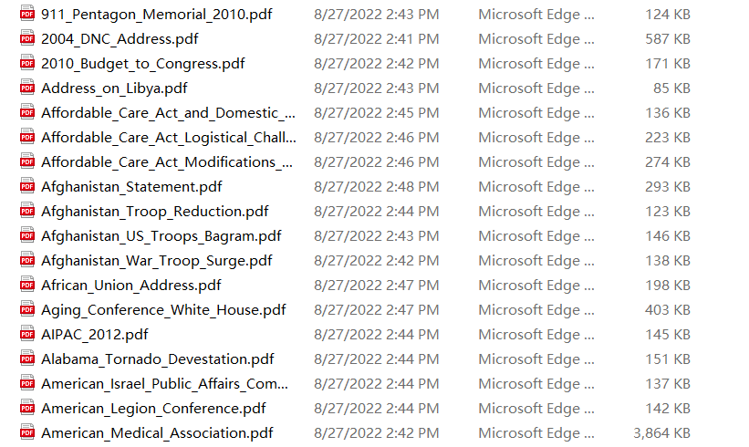
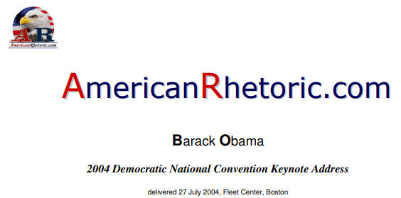

Web Scarping
Downloading PDFs
Method: Beautifulsoup
Extracting text from PDFs
Method: PDFplumber
Text processing
Method: Regular Expression

Slide 5

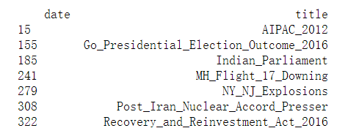
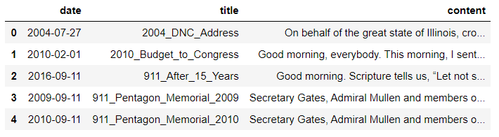
Web Scarping
Processing Missing Values
Dates of certain speeches
Selecting speeches which are given during Obama’s tenure
Finally, get the raw data of speeches and the number of speeches is 405

Slide 6
Data Process

Slide 7


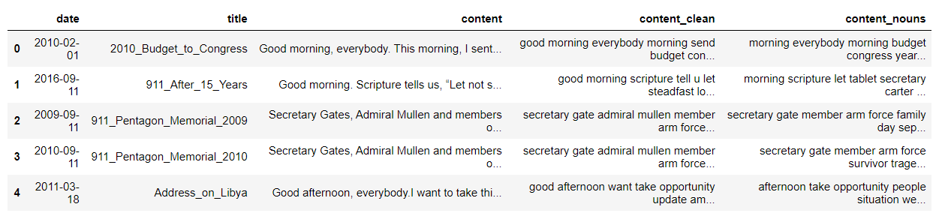
Data Process
Remove Stopwords Remove Punctuations
Lower Words Extract nouns
Lemmatize Tokenize
Words lemmatized
and tokenized
Data after processed

Slide 8
Top2Vec

Slide 9


Top2Vec
Top2Vec is an algorithm for topic modeling.
It automatically detects topics present in text and generates jointly embedded topic, document and word vectors.
Package: Top2Vec
1.Create a joint embedding of document and word vectors.
2.Find dense clusters of documents
3.Identify which words attracted those documents together.
4.Each dense area is a topic
5.The words that attracted the documents are the topic words.

Slide 10
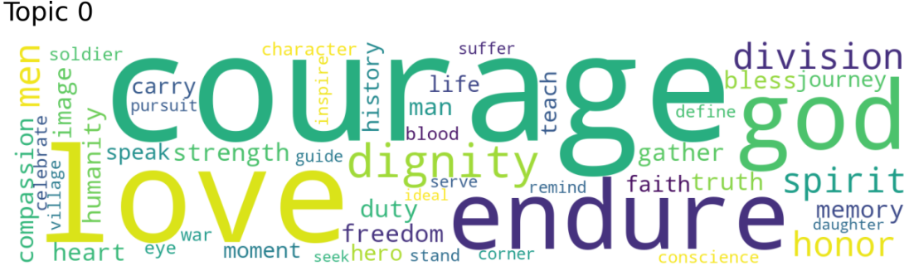
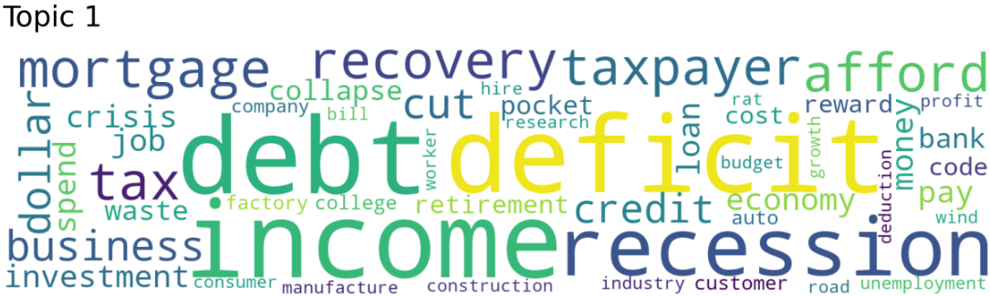
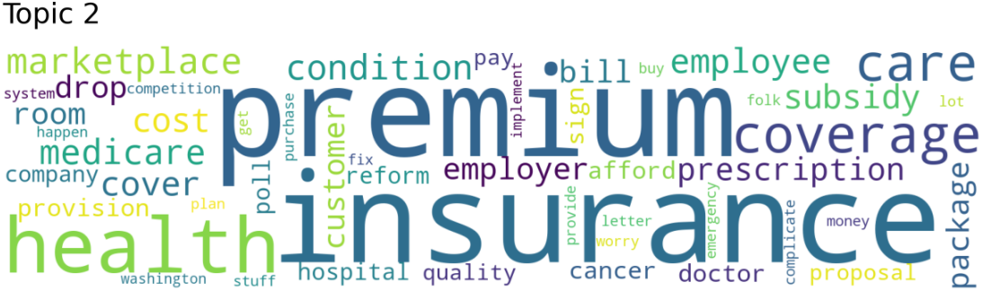
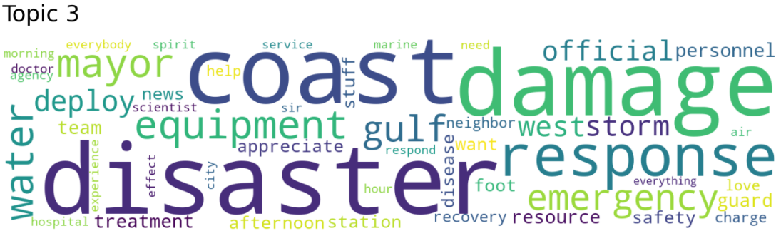
Top2Vec
The topic number detected is 4.
Just a preliminary analysis of the number of topics in topic modeling.

Slide 11
K-means Cluster

Slide 12
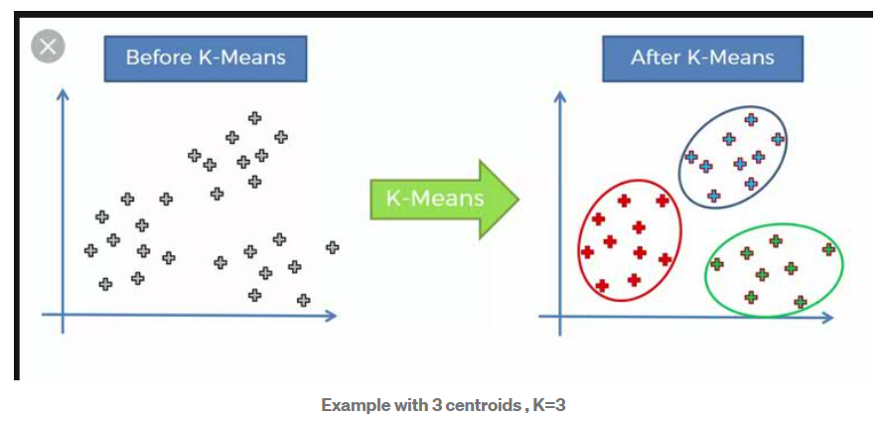
K-mean Cluster
K-means: Grouping similar data points together and discover underlying patterns. It belongs to Unsupervised Learning.
It identifies k number of centroids, and then allocates every data point to the nearest cluster.
Package: Cluster

Slide 13
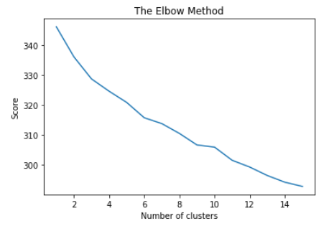
K-means Cluster
How to find the optimal number of clusters?
Elbow method
The location of a bend (knee) in the plot is generally considered as an indicator of the appropriate number of clusters.
K = 9

Slide 14

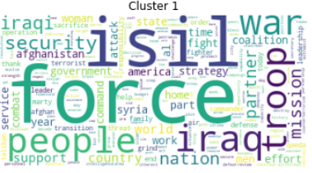
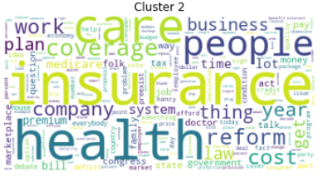
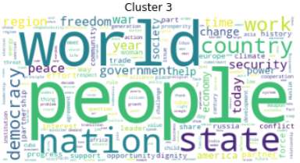
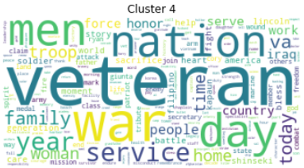
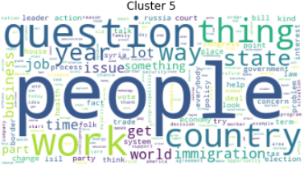
K-means Cluster

Slide 15
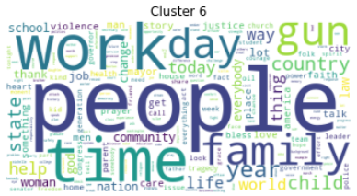


K-means Cluster
Notice that the most common word in cluster 3, 5, 6 is people.

Slide 16
LDA- Latent Dirichlet Allocation

Slide 17
LDA Model
Latent Dirichlet Allocation (LDA) is an example of topic model and is used to classify text in a document to a particular topic. It builds a topic per document model and words per topic model, modeled as Dirichlet distributions.
1.Tokenize speeches
2.Create a dictionary
3.Create a corpus
4.Calculate corresponding scores to choose the optimal topic number
5.Build LDA model
6.Topic Visualization

Slide 18
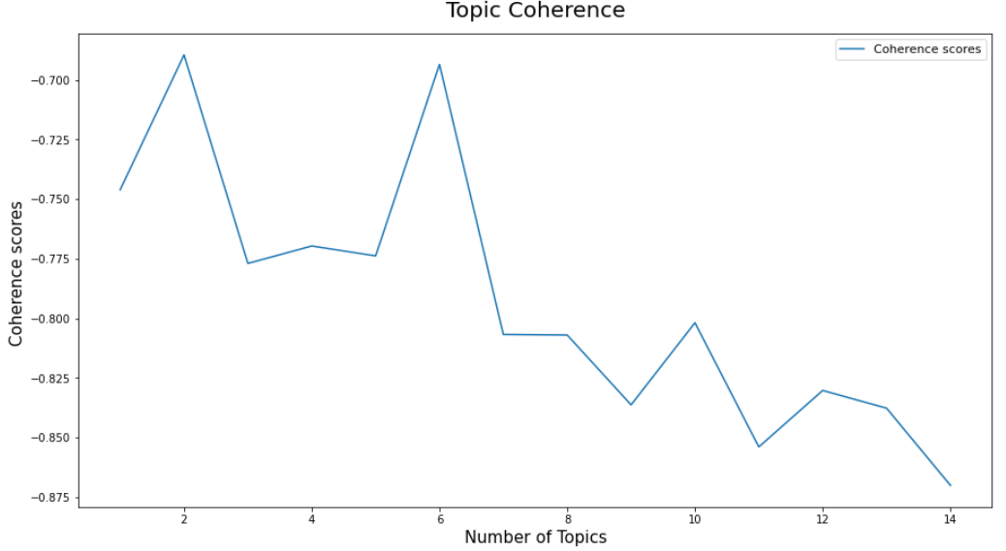
LDA Model
How to find the optimal topic number?
Coherence Score
Topic Coherence measures score a single topic by measuring the degree of semantic similarity between high scoring words in the topic.
K = 6
With the coherence score seems to keep decreasing with the number of topics, pick the model that gives the highest score before a major drop.

Slide 19
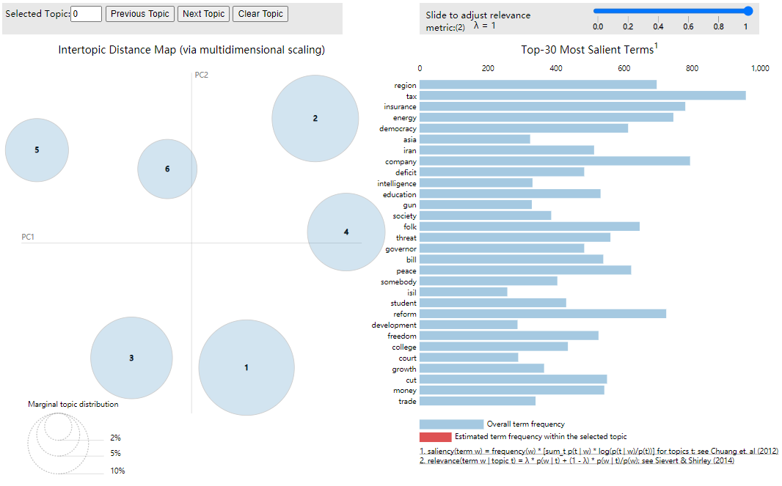
LDA Model
Topic Visualization
Method: pyLDAvis
Notice that big, non-overlapping circles scattered throughout the chart instead of being clustered in one quadrant.
It’s a good topic model

Slide 20
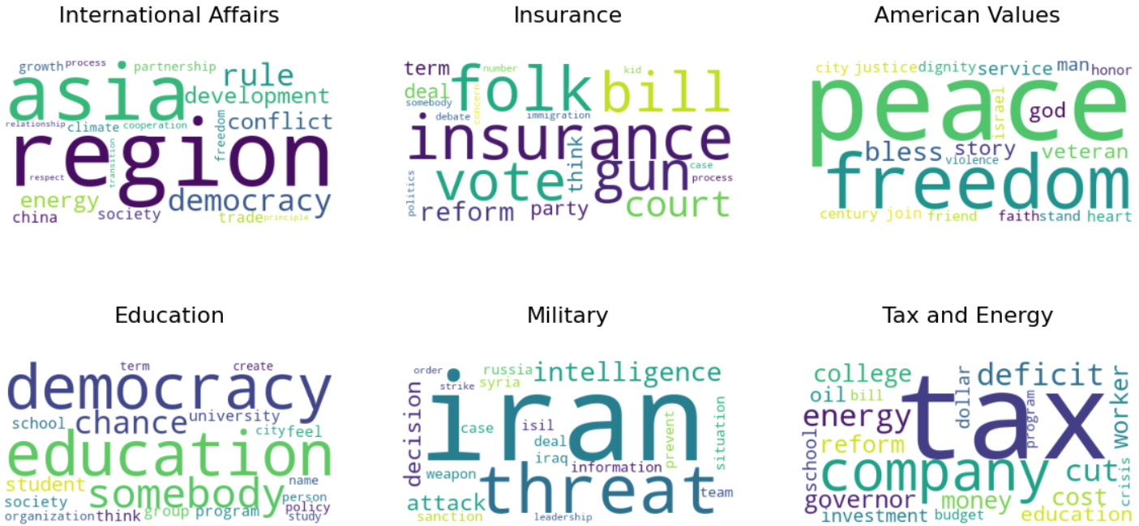
LDA Model

Slide 21
External Data Analysis

Slide 22
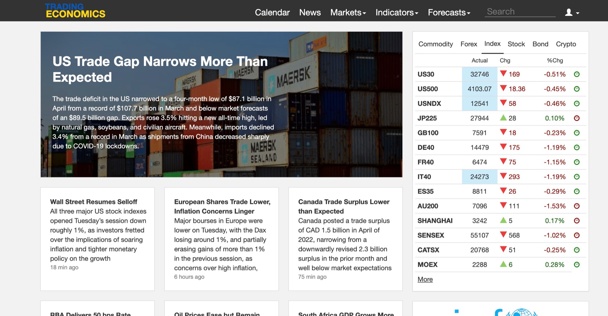
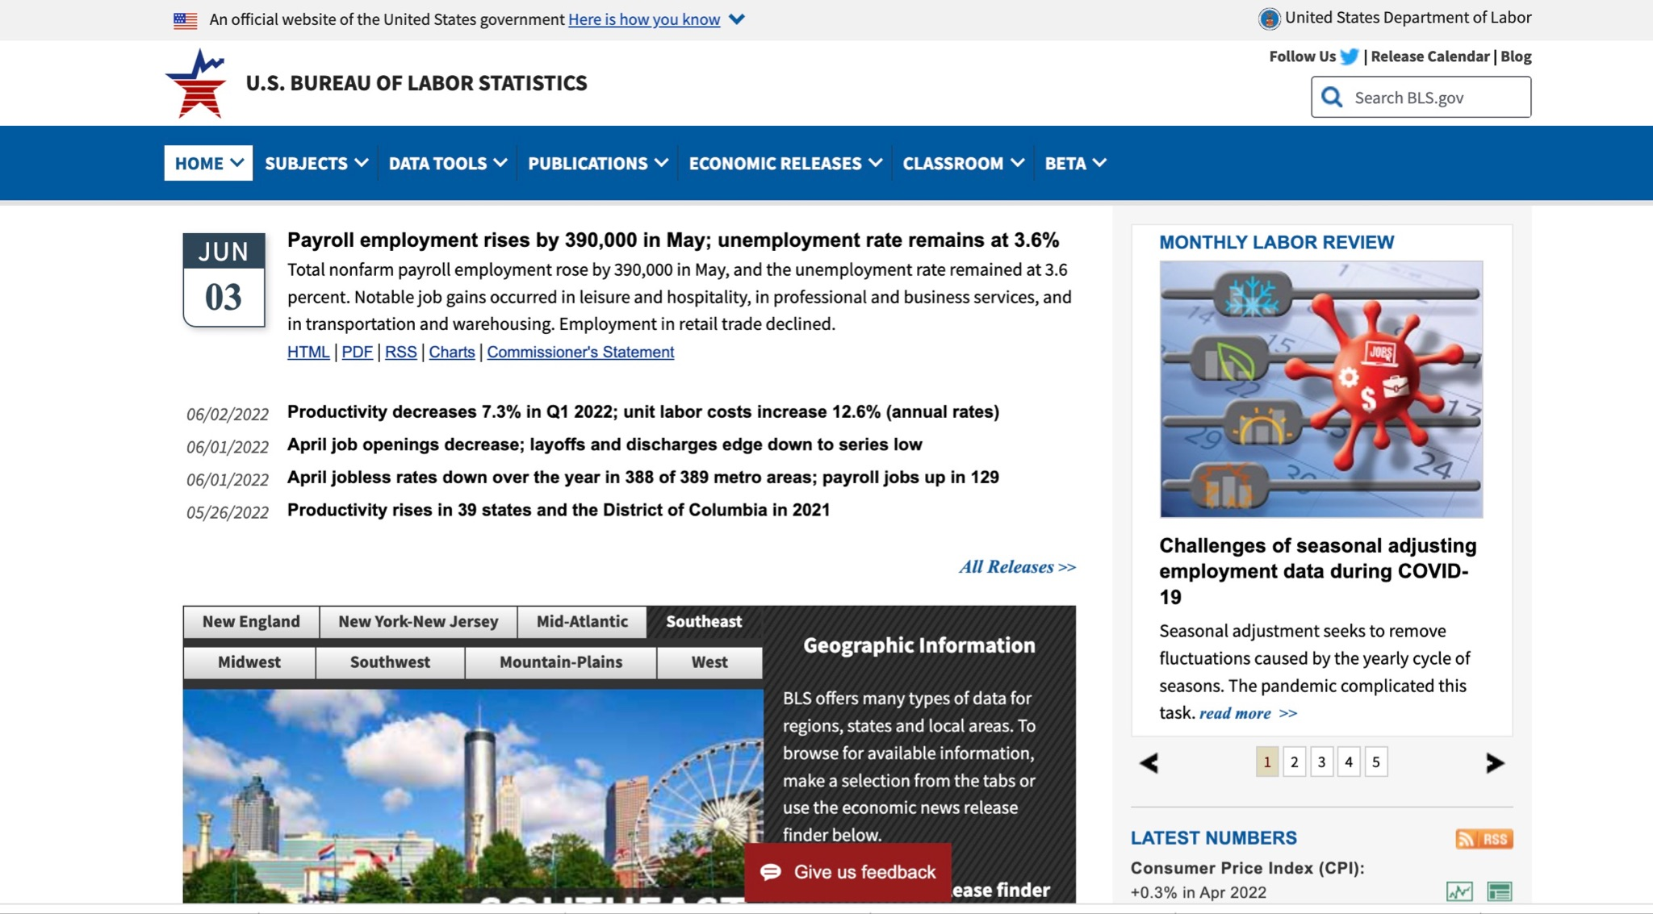

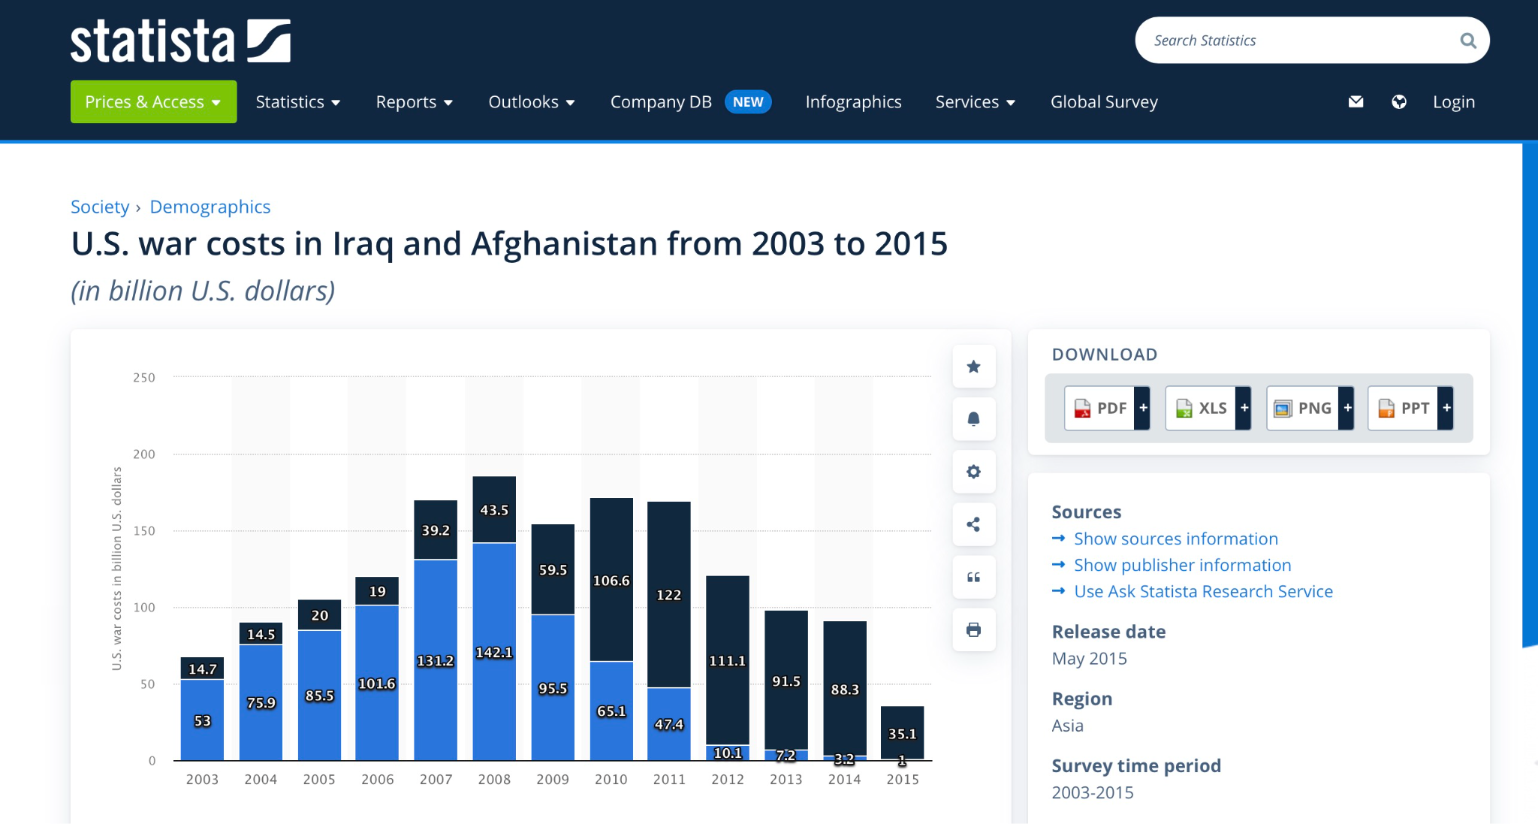
US. Military Spending US. Uninsured population US. Tax Revenue
US. Energy Consumption
Obama Support Rate
External Variables by year

Slide 23
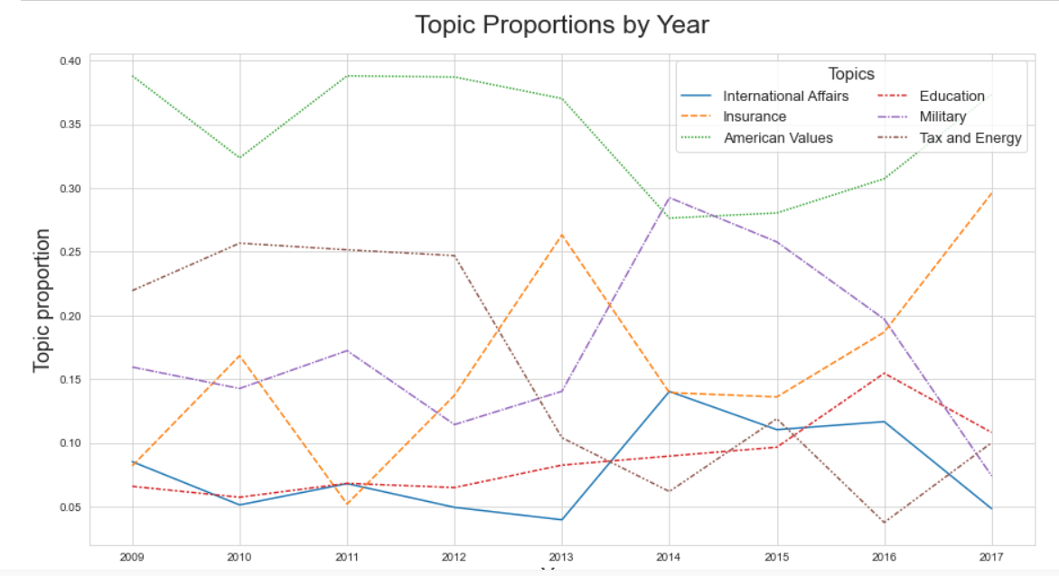
External Data Analysis

Slide 24
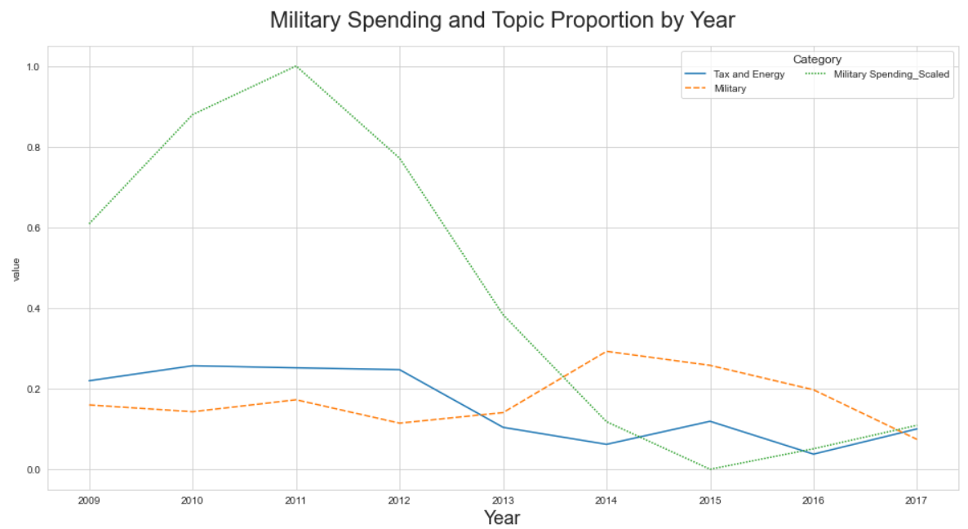
External Data Analysis

Slide 25
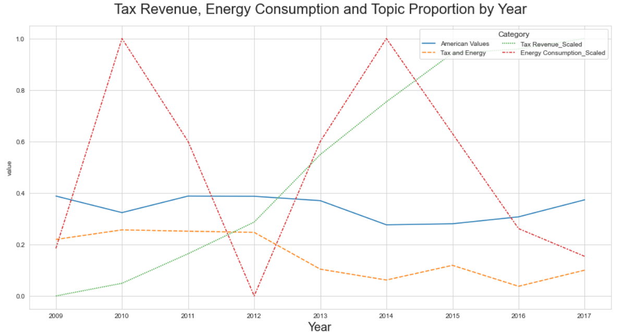
External Data Analysis

Slide 26
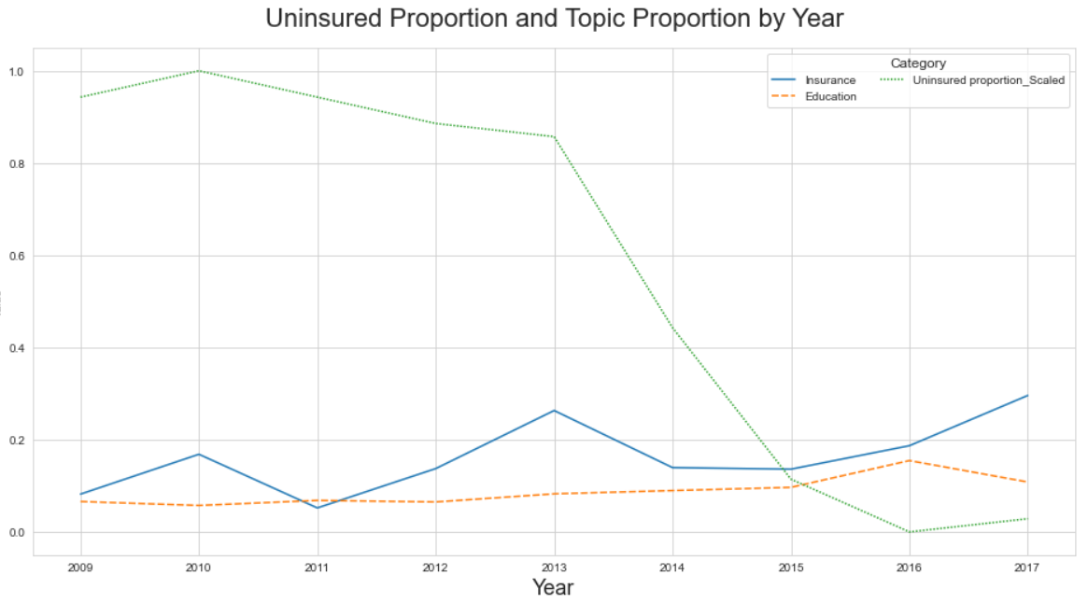
External Data Analysis

Slide 27
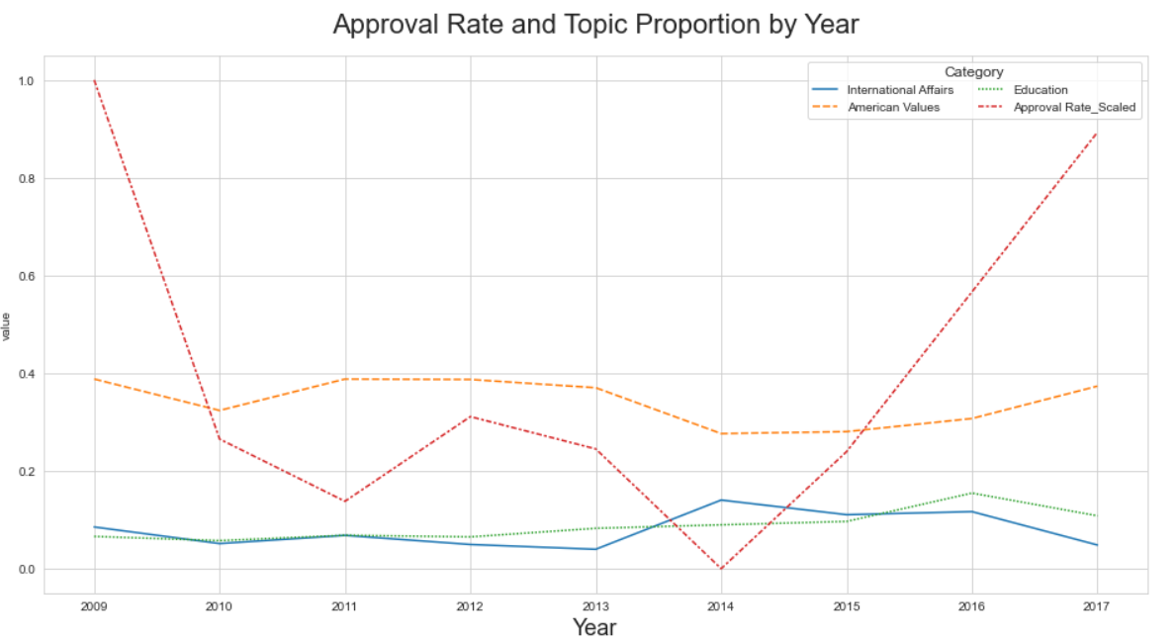
External Data Analysis

Slide 28
Changes

Slide 29
Changes
Compared with last group project, changes on the individual project are:
1.Use regular expression to modify web scraping
2.Modify data processing
3.Delete sentiment analysis
4.Consider more topic model methods, including Top2Vec and K-means cluster

Slide 30
Thanks for watching

